Slide 2
The Modern World-System
Capitalist Agriculture and the Origins of the European
World-Economy in the Sixteenth Century
By
Theda Skocpol
WELCOME
Presenter
Mr. Ajit Thapa
26th December 2021 Sunday

Slide 3


About The author
Theda Skocpol was born in Detroit, Michigan on May 4, 1947. She is an American sociologist and Political Scientist who is currently the Victor S. Thomas Professor of Government and Sociology at
She is a highly influential figure in both sociology and political science.
She has written widely for both popular and academic audiences. She has been President of the American Political Science Association and the Social Science History Association
Her 1979 book States and Social Revolutions was highly influential in research on revolutions, ushering in a new paradigm
In the early 1980s, Skocpol publicly alleged that Harvard University had denied her tenure (1980) because she was a woman.
This charge was found to be justified by an internal review committee in 1981.
In 1984, Harvard University offered Skocpol a tenured position (its first ever for a female sociologist), which she accepted.

Slide 4




The Modern World-System: Capitalist Agriculture and the Origins of the European World-Economy in the Sixteenth Century
WALLERSTEIN'S WORLD CAPITALIST SYSTEM: A THEORETICAL AND HISTORICAL CRITIQUE:
Immanuel Wallerstein's The Modern World-System aims;
To achieve a clean conceptual break with theories of "modernization"
And thus provide a new theoretical paradigm to guide our investigations of the emergence
And development of capitalism,
Industrialism,
And national states.
This impressive undertaking could hardly be more appropriately timed and aimed.
For quite some time, modernization approaches have been subjected to telling critical attacks (e.g., Gusfield 1967; Frank 1966; Bendix 1967; Tipps 1973; Smith 1973; Tilly 1975, chap. 9).

Slide 5
“modernization theorists”
Moreover, modernization theorists have been criticized for the method of explanation they frequently employ: A historical ideal types of "tradition" Vs "modernity" are elaborated and then applied to national cases;
If the evidence seems to fit, one assumes that a particular historical instance is adequately explained; if not, one looks for the "chance" factors that account for its unorthodoxy.
In the opening pages of The Modern World-System, and in a related essay (also published in 1974) called "The Rise and Future Demise of the World Capitalist System,"
Wallerstein unequivocally defines his approach in direct opposition to these features of modernization theory.
Thus in his book he will concentrate on explaining the structure and functioning of capitalism as a world economic system, viewing sovereign states as but "one kind of organizational structure among others within this single social system" (p. 7).
Equally important, he intends to avoid the "intellectual dead-end of a historical model-building" (1974, p. 388) by grounding his theorizing in an analysis of the historically specific emergence and development of capitalism since the sixteenth century.
He hopes thereby to demonstrate “That to be historically specific is not to fail to be analytically universal," that "the only road to nomothetic propositions is through the historically concrete" (1974, p. 391).

Slide 6
modernization theorists…..
The Modern World-System is a theoretically ambitious work that deserves to be critically analyzed as such.
Wallerstein's arguments are too misleading theoretically and historically to be accepted at face value.
Because The Modern World-System does suffer from inadequacies of reasoning and evidence, there may be hypercritical reviews that will use the book's weaknesses as an excuse for dismissing out of hand any such world-historical or Marxist-oriented approach.
With such an evaluation I have no sympathy. Like many other important pioneering works, Wallerstein's Modern World-System overreaches itself and falls short of its aims.
It is therefore incumbent especially upon those of us who are sympathetic to its aims to subject this work to rigorous critical scrutiny.
For the true contribution of The Modern World-System will lie, not in the proliferation of empirical research based uncritically upon it, but in the theoretical controversies and advances it can spark among its friends.
In this spirit, let me begin the necessary process of critique in this review essay.

Slide 7
Wallerstein insists that;
Any theory of social change must refer to a "social system"-that is, a "largely self-contained" entity whose develop mental dynamics are "largely internal" (p. 347).
For self-containment to obtain, he reasons, the entity in question must be based upon a complete economic division of labor.
Leaving aside small-scale, isolated subsistence societies, there have been, he says, only two kinds of large-scale social systems:
(1) Empires, in which a functional economic division of labor, occupationally not geographically based, is subsumed under an overarching, tribute-collecting imperial state, and
(2) World economies, in which there are multiple political sovereignties, no one of which can subsume and control the entire economic system.
A world economy should be, in Wallerstein's view, more able than a world empire to experience sustained economic development precisely because economic actors have more freedom to maneuver and to appropriate and reinvest surpluses.
Such a world economy-of which capitalism from the sixteenth century to the present has been (according to Wallerstein) the only long-lasting historical instance-is based upon a geographically differentiated division of labor, featuring three main zones;

Slide 8
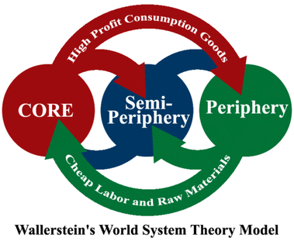
Three main zones
Core,
Semi periphery,
And Periphery tied together by world market trade in bulk commodities that are necessities for everyday consumption.
Each major zone of the world economy has an economic structure based upon its particular mixture of economic activities (e.g., industry plus differentiated agriculture in the core; monoculture in the periphery) and its characteristic form of "labor control"

Slide 9
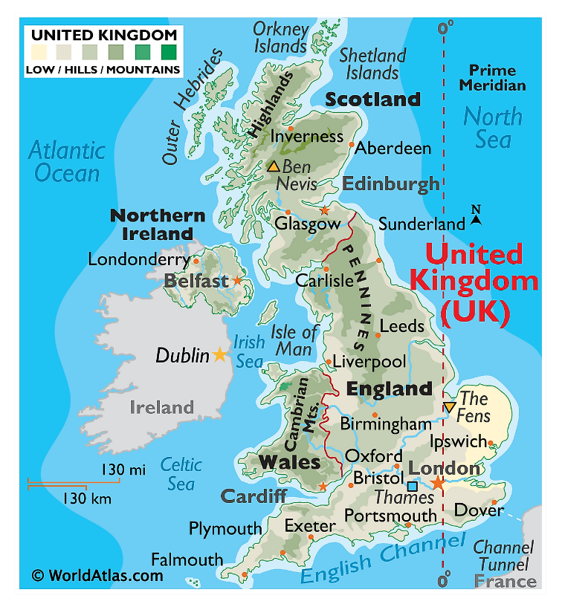
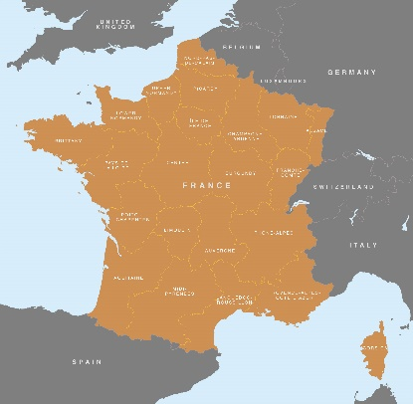
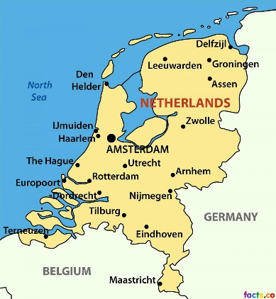
Wallerstein divides the world into four categories of the regions consisting of a few countries. These categories are reflective of the political and economic characteristics and also the relative positions of the countries in the world system.
The four categories of world are as follows:
1. The Core:
During 1450-1670, the north-western Europe developed as the first core region. This region consisted of England, France and Holland.
The states in this region developed strong governments and bureaucracies which helped them to have control over inter­national commerce and extract surpluses from this trade for their own benefit.
As a result of the crisis of feudalism, the peasants who were rendered landless and had to migrate to cities, provided cheap labour for urban industry which helped its development.

Slide 10
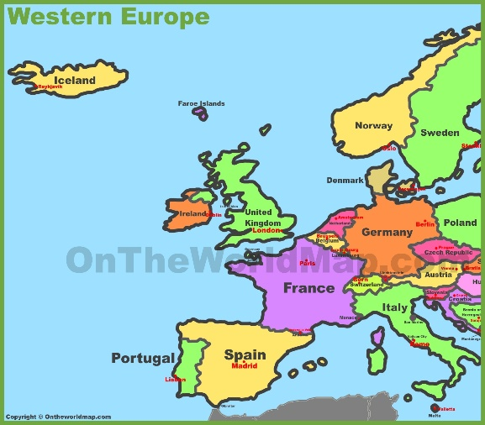
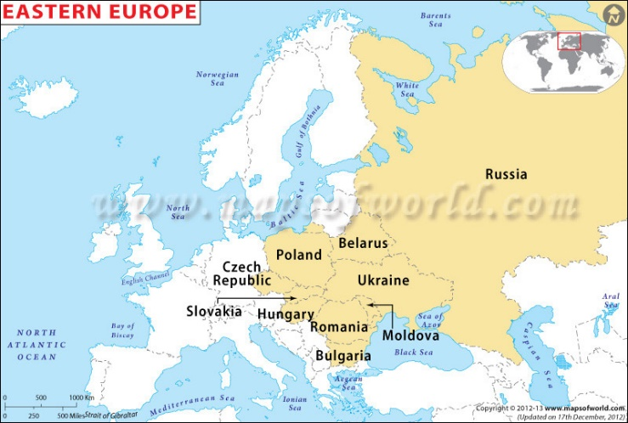
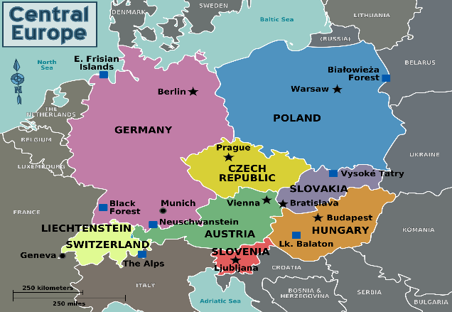
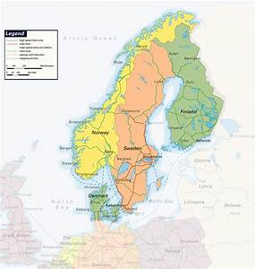
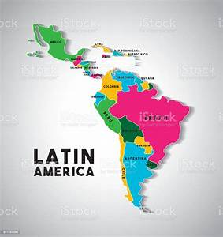
2. The Periphery:
The countries put in this category are the East European countries (especially Poland) and Latin America.
These countries lacked their own strong governments and were controlled by other states.
They exported raw material to the core region. They extracted much of the capital surpluses of these countries through migrant exchange.
The labour in this region was forced and made to provide cheaper raw material to be exported to Europe.

Slide 11
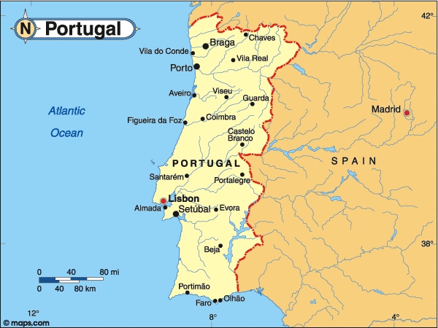
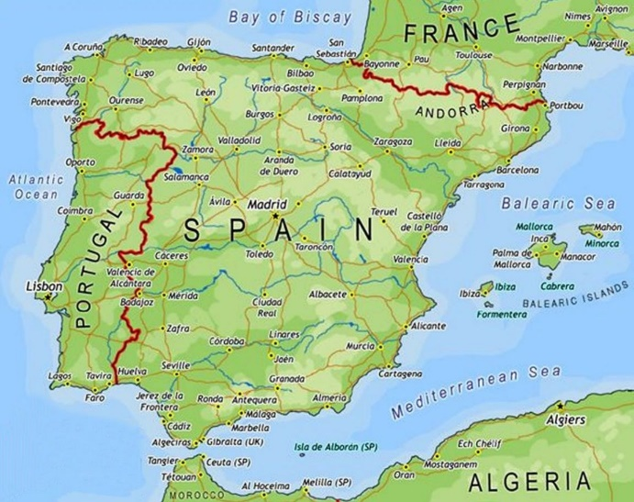
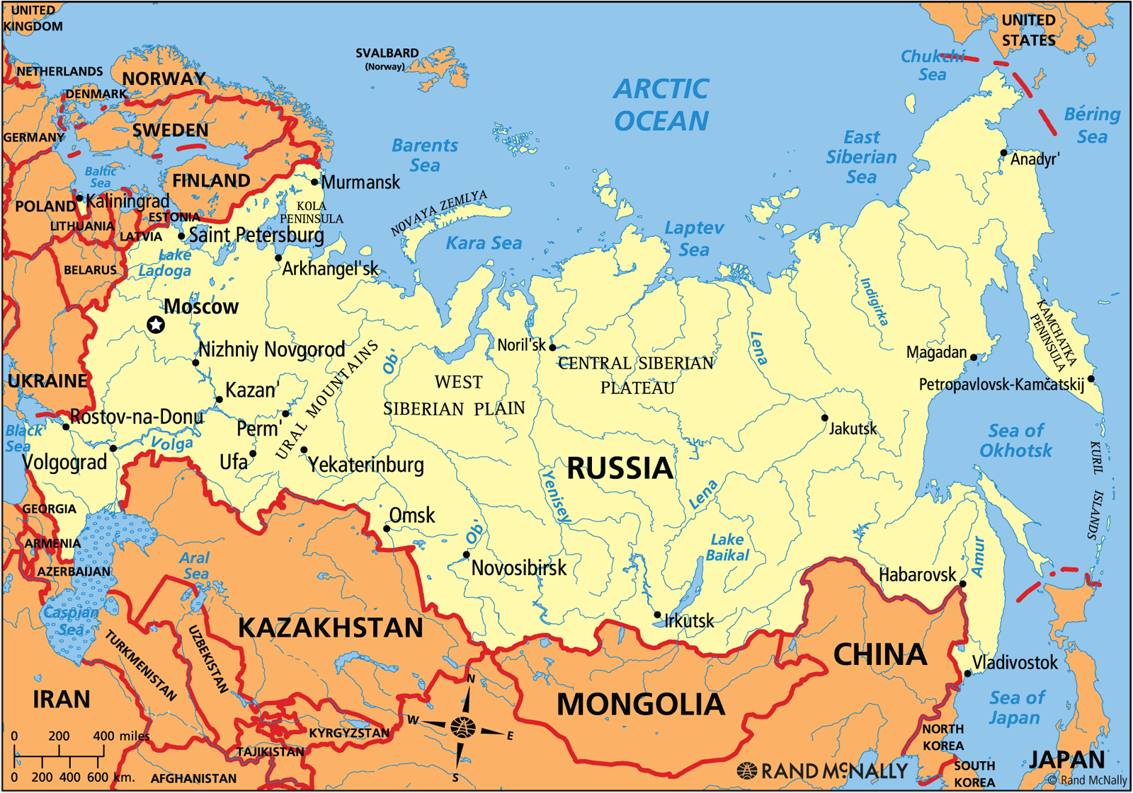
3. Semi-periphery:
This region lies between the core and the periphery regions.
It consists of the countries of the core region which are facing decline in their economy and those of the periphery whose economy is improving.
Wallerstein cites the example of Portugal and Spain, which slipped from their core position to that of semi-peripheries.
The core exploited the semi-periphery, which exploited the peripheries.
4. External Areas:
These are the areas which maintain their own economic system.
The internal trade is given importance by the countries of this region. Russia is the best example of this region.

Slide 12
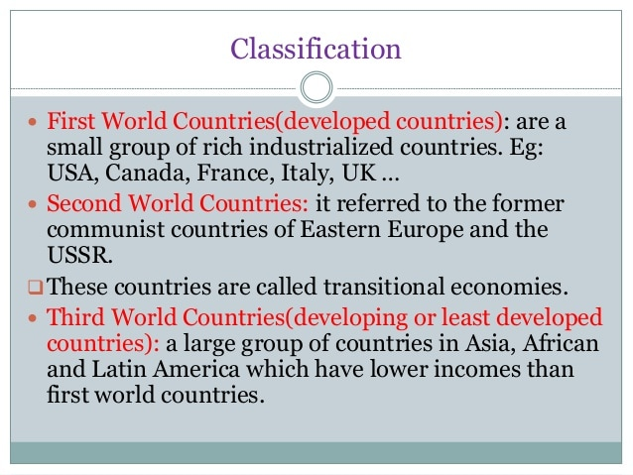

Slide 13
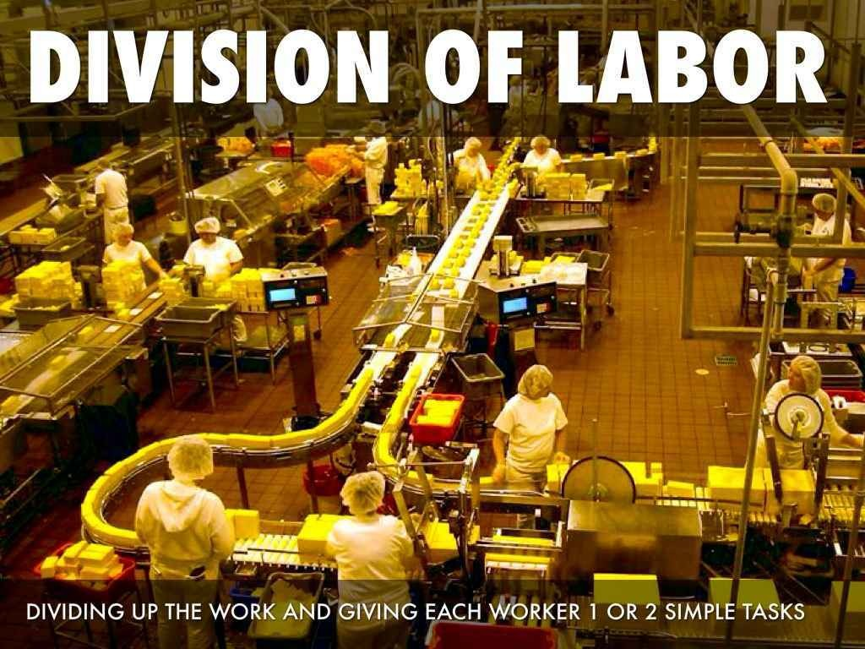

"Labor control"
e.g., skilled wage labor and tenant in the core;
Sharecropping in the semi periphery;
And slavery or "coerced cash-crop labor" in the periphery.
The different zones are differentially rewarded by the world economy, with surplus flowing disproportionately to the core areas.
Moreover, the economic structure of each zone supports a given sort of dominant class oriented toward the world market, as well as states of a certain strength
(strongest in the core and weakest in the periphery) that operate in the interests of that class.
Finally, according to Wallerstein, The differential strength of the multiple states within the world capitalist economy is crucial for maintaining the system as a whole, for the strong states reinforce and increase the differential flow of surplus to the core zone.
This happens because strong states can provide "EXTRA-ECONOMIC" assistance to allow their capitalist classes to manipulate and enforce terms of trade in their favor on the world market.

Slide 14
Let us reflect for a moment upon this model as a whole.
Historically, one of the most striking things about capitalism has been its inherent dynamism.
From a world-historical perspective, we need to understand how and why capitalism emerged, has developed, and might one day pass from the scene.
Wallerstein clearly appreciates the importance of these issues yet he does not offer very many insights about them, either in MWS or in his "Rise and Demise" article (where he sketches an overview of four stages of world capitalist development from the sixteenth century to the present).
In the "Rise and Demise" article (1974), the significant consequences of the technological innovations achieved in the Industrial Revolution are much discussed, but not a word is said about the causes of the Industrial Revolution.
Causes of the Industrial Revolution.
the emergence of capitalism, 2. European imperialism,
3. efforts to mine coal, 4. and the effects of the Agricultural Revolution.

Slide 15


world capitalist system are market processes
The only definite dynamics of Wallerstein's world capitalist system are market processes:
commercial growth,
Worldwide recessions,
And the spread of trade in necessities to new regions of the globe.
Apparently the final demise of the system will come after the market has spread to cover the entire globe and transform all workers into wage laborers.
But even the all-important dynamic of global expansion itself depends upon the occurrence of technological innovations-themselves unexplained

Slide 16
the stability of the world capitalist system
Wallerstein is very forceful on the subject of the stability of the world capitalist system.
In theory, as we have seen, once the system is established, everything reinforces everything else.
Wallerstein consistently employs not only system-maintenance arguments but also direct analogies between the structure of the world capitalist system and the typical structure of political empires (e.g., pp. 349-50) to convey a sense of the massive stability of the whole.
The essential structures of world capitalism
To patterns of division of labor and of relationships among states in different economic positions that have endured since the sixteenth century even though the system as a whole has expanded geographically and particular countries have changed positions within the system.

Slide 17
close critical look
Ideas about factors of socioeconomic and political structures that are built into Wallerstein's model of the world capitalist system
We can most readily pinpoint the problematic points, the model is based on a two-step reduction:
- first, a reduction of socio economic structure to determination by world market opportunities and technological production possibilities;
- And second, a reduction of state structures and policies to determination by dominant class interests.
The differences of economic structure among his three major zones of core, semi periphery, and periphery lead him to make the first reduction.
The crux of the differences is the “Mode of Labor Control" “Adopted" in each zone by the dominant classes oriented to the world market.

Slide 18
close critical look….
Dominant classes do labor control
Marxist idea
Institutionalized relationships between producing and surplus-appropriating classes
Allow for the ever-present potential of collective resistance from below.
Wallerstein treats "labor control" primarily as a market-optimizing strategy of the dominant class alone.
His reliance on liberal economics is a non-exploitative picture of the process of income distribution within the world system
Wallerstein repeatedly implies that the dominant classes choose freely among alternative strategies of labor control by assessing rationally the best means for maximizing profits, given the;
geographical,
demographic,
technological,
and labor-skill conditions

Slide 19
Would a liberal economist say anything different, since all that is being argued here is that regions with the occasional factors of production are differentially rewarded by the market?
-Yes, of course, Wallerstein does argue theoretically that the structure and functioning of the world capitalist economy are inherently exploitative.
He does so by assigning the international hierarchy of dominating and dominated states (especially core vs. periphery) a crucial mediating role in exacerbating and sustaining overall inequalities in the system as a whole.
- "Once we get a difference in the strength of the state machineries, we get the operation of 'unequal exchange' which is enforced by strong states on weak ones, by core states on peripheral areas.
-Thus capitalism involves not only appropriation of surplus-value by an owner from a laborer, but an appropriation of surplus of the whole world-economy by core areas"

Slide 20
How are degrees of state strength and kinds of
state economic policies to be explained?
Here we arrive at the second reduction built into Wallerstein's model. For in his theory;
Differences of state strength and policies among states located in different major zones of the world system are explained as the result of differences in regional rates of surplus appropriation
-And, above all, as the expressions of the different world market interests of the dominant classes within the national political arenas that happen to be located in each major zone (chap. 3, passim).
-Thus the core area ends up with strong states primarily because there are more plentiful surpluses to tax and because the dominant capitalist classes want state protection for industry and their control of international trade;
-An the other hand, the periphery ends up with weak or nonexistent states because it reaps less from world trade and because its dominant capitalist classes are interested in profiting from direct dealings with merchants from the core areas.

Slide 21
differences in state strength
-Wallerstein relies upon arguments about economic conditions and world market interests,
-Largely ignoring other potentially important variables such as historically preexisting institutional patterns,
-Threats of rebellion from below, and geopolitical pressures and constraints.
- Wallerstein must make this second reduction, of politics to world market-oriented class interest, in order to be able to assert that the system will be exploitative, and stably so over the long run
-Without a hierarchy of dominating and dominated states corresponding to the existing pattern of economic differentiation, there is no worldwide "unequal exchange" in this theory.

Slide 22
Do these theoretical peculiarities matter ?
Certainly some quite unbelievable assumptions have to be made to make the model internally consistent.
Since everything is directly or indirectly an expression of capitalist class interests (under given technical conditions),
We are forced to assume that these classes always get what they want,
Reshaping institutions and their relations to producing classes to suit their current world market opportunities.

Slide 23
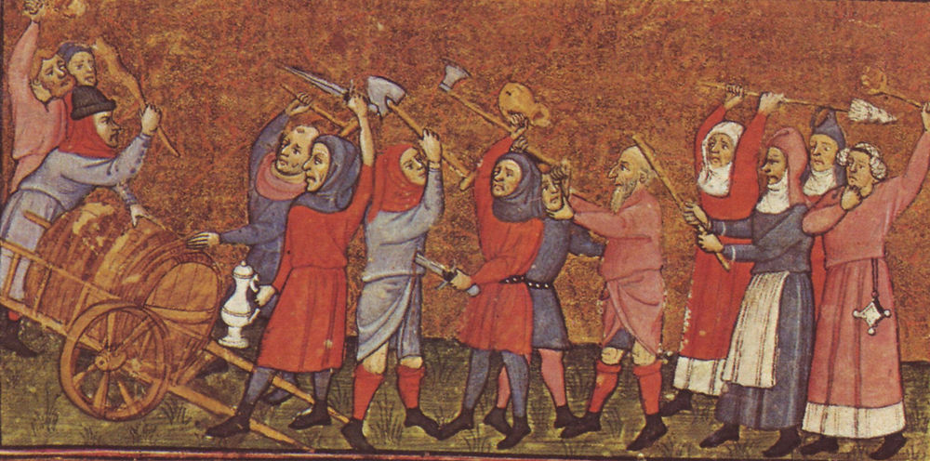
Examining in turn two major early modern European developments that Wallerstein himself stresses in The Modern World-System:
The resolution of the “Crises of Feudalism" into opposite socioeconomic structures in Eastern versus Western Europe; and
The emergence of Monarchical Absolutisms.

Slide 24
East vs West
Differences of political history and of the relative strength of towns have also to be taken into consideration in order to explain the socioeconomic divergences of East and West.
But Brenner raises some important warnings about the influence of towns on the course of agrarian class struggles.)
“Historically specific patterns of development of the contending agrarian classes and their relative strength in the different European societies;
a. Their relative levels of internal solidarity, b. Their self-consciousness and organization, and c. Their general political resources .
Eastern peasants were more easily and thoroughly dominated by their landlords because, for various specific historical reasons,
They enjoyed much less village community solidarity and local political autonomy than did Western European peasants.
The Eastern peasants found it more difficult, especially over the long run, to resist the lords collectively.

Slide 25
Wallerstein's world-market theory
Wallerstein's world-market theory prevents him from adequately explaining patterns of economic development in early modern Europe, it leaves him even less able to make sense of the patterns of state development.
To impose proto bureaucratic administrative controls and coercive monopolies over large populations and territories.
Wallerstein recounts the phenomena of absolutism and tries to subsume them within his theory by invoking the category of the "strong state."
Strong states necessarily grow up in the core zone of the world capitalist economy.
"In the sixteenth century, some monarchs achieved great strength.
In the core states there evolved relatively strong State systems, with an absolute monarch and a patrimonial State bureaucracy working primarily for this monarch.
Netherlands and England were, according to Wallerstein's analysis, core countries.

Slide 26



English monarchs
English monarchs had no large standing armies and no bureaucratic administration that penetrated the localities.
In fact, the English monarchs could rule only through
Cooperation with locally powerful notables,
the county-Parliamentary gentry
and the London merchant oligarchy.

Slide 27


What about the true absolute monarchies of Europe, such as the Spanish, the French, and the Swedish?
Wallerstein stresses the bureaucratic weight and military aggressiveness of the Spanish state whenever he is trying to account for European domination of the New World
Spain drops out of the picture, even though her monarchy remained thoroughly absolutist and, arguably, just as internationally powerful as the English government throughout the entire historical period under consideration
Wallerstein believes that he need not treat Spain and England as comparable in the same analytic terms. Instead he builds a series of contrasts between
Spain as a would-be empire
England as a would-be national state.

Slide 28
Wallerstein's world system approach
We should investigate the world-historical emergence and development of capitalism in terms of hypotheses about variations in both
(1) Institutionalized class relations of production and exchange, and
(2) Patterns of state structures and interstate relationships, without simply reducing the latter to the former.
The alternative picture of world capitalism that is likely to emerge from historical analyses pursued along these lines will probably pertain to intersecting structures
Class structures; The hierarchical organization by which a society or community is divided into classes
Trade networks ; Network of economic exchange linking companies or countries.
State structures; The organizational form of the state, i.e. the distribution of power among agencies between the government and society at large.
Geopolitical systems; The study of the relationship among politics and geography, demography,
and economics, especially with respect to the foreign policy of a nation.

Slide 29
Wallerstein's approach, two methodological criticisms need to be made
The first has to do with the way Wallerstein handles historical evidence in relation to his theory-building enterprise.
In many of the arguments cited in this essay, we have witnessed the major method of argumentation to which Wallerstein resorts:
- The teleological assertion. Repeatedly he argues that things at a certain time and place had to be a certain way in order to bring about later states or developments that accord (or seem to accord) with what his system model of the world capitalist economy requires or predicts
Wallerstein's approach very disturbing because it has the effect of creating an impenetrable abyss between historical findings and social science theorizing.
Wallerstein creates an opposition between a formalistic theoretical model of universal reference, on the one hand, and the particularities and "accidents" of history, on the other hand-an opposition that Uncannily ( Mysterious or impossible to explain), resembles the relationship between theory and history in the ideal type method of the modernization approach.

Slide 30
How could these things happen, given Wallerstein's original intentions?
The answer, the "mirror image" trap that waves any attempt to create a new paradigm through direct, polemic ( Bold and out spoken ) opposition to an old one.
Social science may, as is often said, grow through arguments. But it can also stagnate (Go Bad ) through them, if innovators uncritically carry over unfashionable theoretical categories (e.g., "system") and if they define new ones mainly by searching for the apparently direct opposite of the old ones
(e.g., “World system" vs. “National system").
World-system theory is a macro sociological perspective that seeks to explain the dynamics of the “capitalist world economy” as a “total social system”.
Wallertein - A world-system is a social system, one that has boundaries, structures, member groups, rules of legitimation, and coherence.
National System helps business and governmental organizations to plan, design, implement and operate complex, scalable reform projects
Wallerstein has so far given imperfect answers about the historical development of capitalism,
Still he has had the unparalleled boldness of vision to raise all the important issues.
Even the shortcomings of his effort, therefore, can be far more fruitful for the social sciences than many minute successes by others who attempt much less.

Slide 31
conclusion

Slide 32
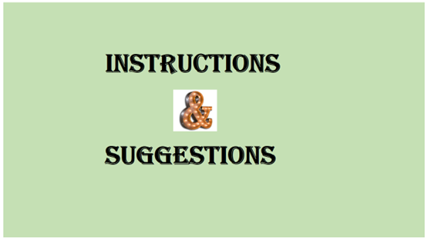
Class 1. “The continuity thesis on world development”
– Sunday 2nd January 2022 (……………………………………………………………..)
Class 2.– “World System : Simileritie and differences “
-Sunday 9th January 2022 (……………………………………………………………….)

